Slide 1

EEE 421 VLSI Circuits

Slide 2
CMOS Properties
Full rail-to-rail swing ⇒ high noise margins
  Logic levels not dependent upon the relative device sizes ⇒ transistors can be minimum size ⇒ ratioless
Always a path to V_{dd} or GND in steady state ⇒ low output impedance (output resistance in kΩ range) ⇒ large fan-out (albeit with degraded performance)
Extremely high input resistance (gate of MOS transistor is near perfect insulator) ⇒ nearly zero steady-state input current
No direct path steady-state between power and ground ⇒ no static power dissipation
Propagation delay function of load capacitance and resistance of transistors
Notes:
rail-to-rail - Vdd to 0V giving good noise margins
power dissipation - no path between Vdd and Gnd in steady state (ignores leakage current)
ratioless - logic levels are not dependent upon relative device sizes (as in NMOS), so transistors can be minimum size
single inverter can theoretically drive an infinite number of gates and still be functionally operational; fan-out increases propagation delay
steady state path to Vdd or Gnd - low output impedance, so less sensitive to noise

Slide 3
Transforming PMOS I-V Lines
Want common coordinate set V_{in}, V_{out}, and I_{Dn}
I_{Dn}
I_{DSp} = -I_{DSn}
V_{GSn} = V_{in} ; V_{GSp} = V_{in} - V_{DD}
V_{DSn} = V_{out} ; V_{DSp} = V_{out} - V_{DD}
V_{out}
V_{in} = 0
V_{in} = 0
V_{in} = 1.5
V_{in} = 1.5
V_{GSp} = -1
Mirror around x-axis
V_{in} = V_{DD} + V_{GSp}
I_{Dn} = -I_{Dp}
Horiz. shift over V_{DD}
V_{out} = V_{DD} + V_{DSp}
V_{GSp} = -2.5
Notes:
Do inverter transistor schematic on the board labeling all sources, drains, and gates.

Slide 4
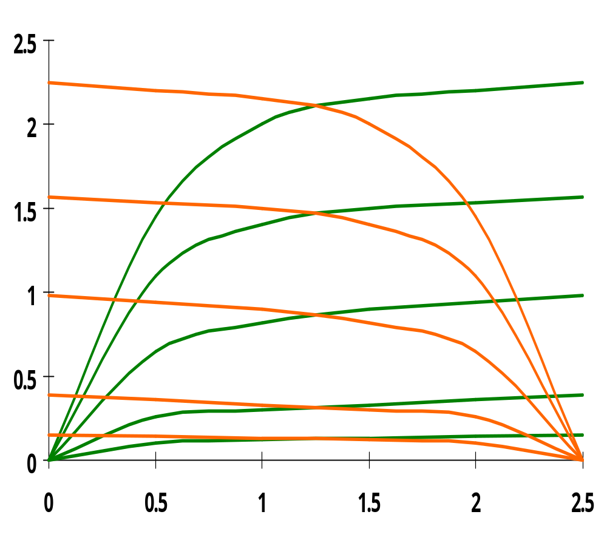
CMOS Inverter Load Lines
PMOS
X 10⁻⁴
NMOS
V_{in} = 0V
V_{in} = 2.5V
V_{in} = 0.5V
V_{in} = 2.0V
I_{Dn} (A)
V_{in} = 1.0V
V_{in} = 1V
V_{in} = 1.5V
V_{in} = 1.5V
V_{in} = 2V
V_{in} = 0.5V
V_{in} = 1.5V
V_{in} = 1.0V
V_{in} = 2.0V
V_{in} = 0.5V
V_{in} = 2.5V
V_{in} = 0V
V_{out} (V)
0.25um, W/L_{n} = 1.5, W/L_{p} = 4.5, V_{DD} = 2.5V, V_{Tn} = 0.4V, V_{Tp} = -0.4V
Notes:
dc points located at the intersection of the corresponding load lines
Note all operating points are located either at the high or low output levels

Slide 5
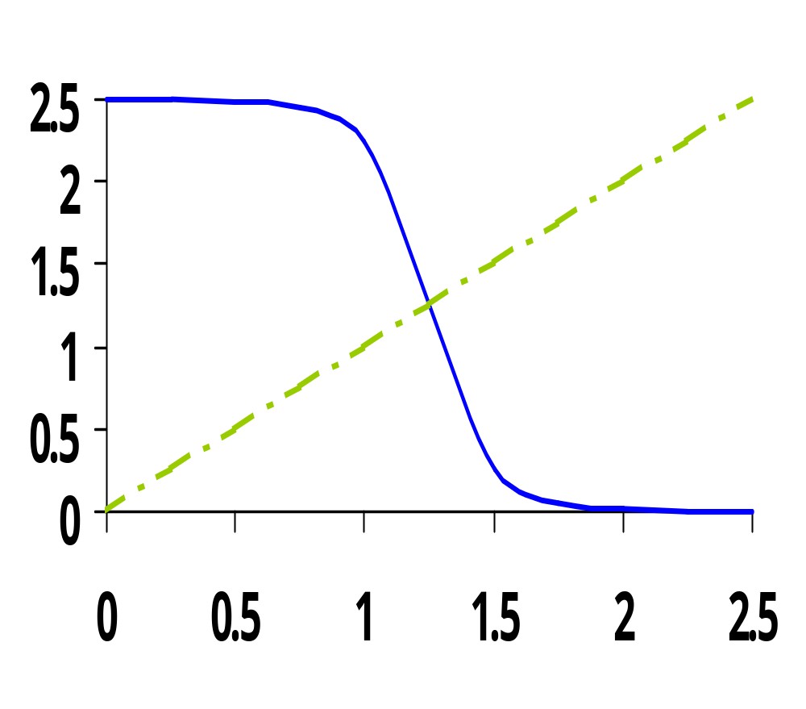
CMOS Inverter VTC
NMOS off
PMOS res
NMOS sat
PMOS res
NMOS sat
PMOS sat
V_{out} (V)
NMOS res
PMOS sat
NMOS res
PMOS off
V_{in} (V)
Notes:
For lecture
VTC of the inverter exhibits a very narrow transition zone; high gain during switching transient (when both PMOS and NMOS are simultaneously on and in saturation). In that region, a small change in input voltage results in a large output voltage variation.
Indicate on VTC plot where VTn and VTp lie

